Slide 1
My Shape and Angles
Interactive Notebook
Name
Class
Term 3 Semester 2

Slide 2
Contents
Formula Page
Page
Date
Description
2
3

Slide 3
Tasks
24
7
30
Essential Question
Questions
Notes
Summary
12
13

Slide 4
24
7
30
Date
Quadrilaterals
How can I use co-interior angles to calculate interior angles in a quadrilateral?
Geogebra - demo
13

Slide 5
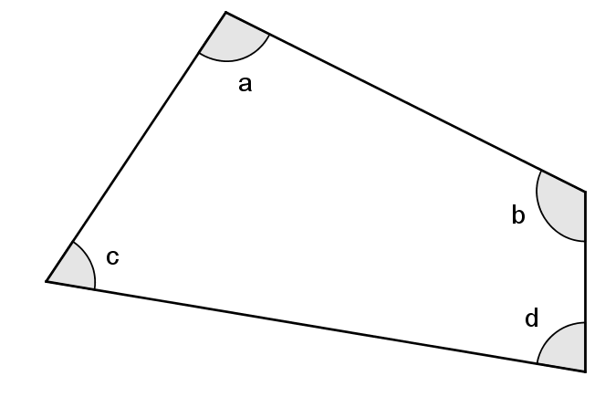


24
7
30
Date
Quadrilaterals
How can I use co-interior angles to calculate interior angles in a quadrilateral add to 360$°$?
Angles in a quadrilateral add to 360$°$
13

Slide 6
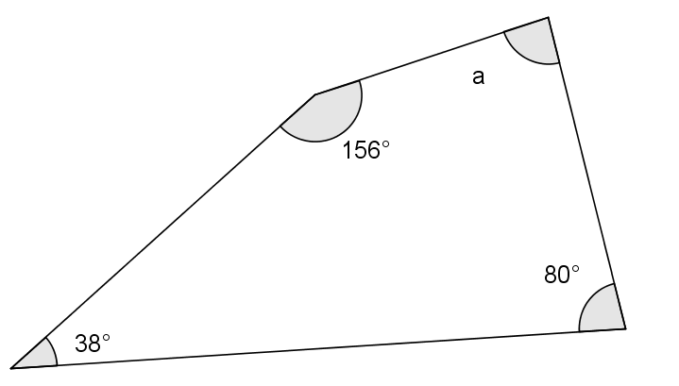
24
7
30
Date
Quadrilaterals
How can I use co-interior angles to calculate interior angles in a quadrilateral add to 360$°$?
Angles in a quadrilateral add to 360$°$
13

Slide 7
24
7
30
Date
Quadrilaterals
How can I use co-interior angles to calculate interior angles in a quadrilateral add to 360$°$?
Angles in a quadrilateral add to 360$°$
156 + 80 + 38 = 274
13

Slide 8
24
7
30
Date
Quadrilaterals
How can I use co-interior angles to calculate interior angles in a quadrilateral add to 360$°$?
Angles in a quadrilateral add to 360$°$
156 + 80 + 38 = 274
360 – 274 = 86
13

Slide 9
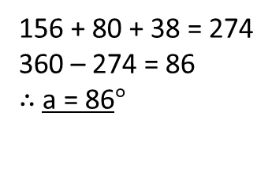
24
7
30
Date
Quadrilaterals
How can I use co-interior angles to calculate interior angles in a quadrilateral add to 360$°$?
Angles in a quadrilateral add to 360$°$
156 + 80 + 38 = 274
360 – 274 = 86
$∴$a = 86$°$
13

Slide 10
24
7
30
Date
Quadrilaterals
How can I use co-interior angles to calculate interior angles in a quadrilateral add to 360$°$?
Angles in a quadrilateral add to 360$°$
156 + 80 + 38 = 274
360 – 274 = 86
$∴$a = 86$°$
Geogebra - demo
13

Slide 11
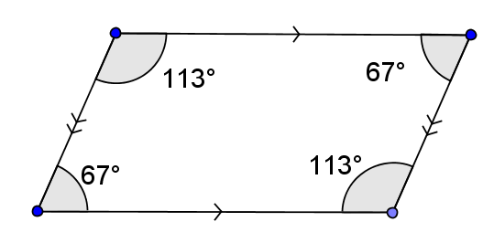

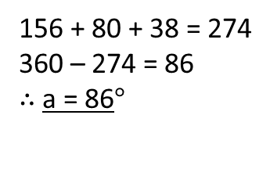
24
7
30
Date
Quadrilaterals
How can I use co-interior angles to calculate interior angles in a quadrilateral add to 360$°$?
156 + 80 + 38 = 274
360 – 274 = 86
$∴$a = 86$°$
Parallelogram or Rhombus
Co-interior angles
Add to 180$°$
13

Slide 12
Questions

Slide 13
24
7
30
Date
Quadrilaterals
How can I use co-interior angles to calculate interior angles in a quadrilateral add to 360$°$?
What do the angles in a quadrilateral add to?
Angles in a quadrilateral add to 360$°$
Example
156 + 80 + 38 = 274
360 – 274 = 86
$∴$a = 86$°$
13

Slide 14
24
7
30
Date
Quadrilaterals
How can I use co-interior angles to calculate interior angles in a quadrilateral add to 360$°$?
156 + 80 + 38 = 274
360 – 274 = 86
$∴$a = 86$°$
Parallelogram or Rhombus
What are the properties of angles in special quadrilaterals?
Co-interior angles
Add to 180$°$
13

Slide 15
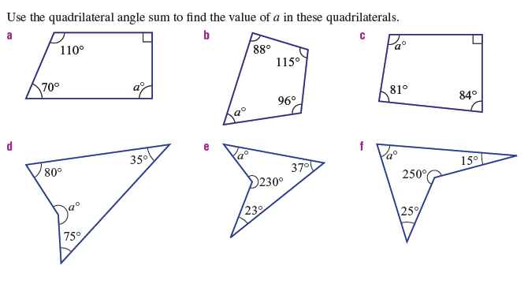
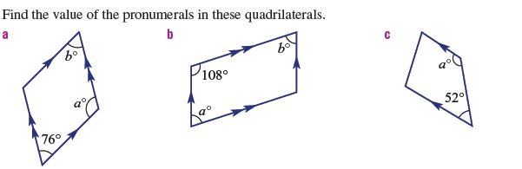
Task

Slide 16


Task

Slide 17
Notes Review
24, 7 ,30
Date
Title
Essential question
Notes complete
Notes complete with colour and diagrams
Questions completed
Contents page filed in
Formula page filled in

Slide 18
Homework
Review your notes and write a summary answering the essential question.

